Slide 1
Digital Image Processing
IT-I Semester, 2010-11
Prof. Suresh Pabboju
IT Dept., CBIT, Hyd

Slide 2
Image Enhancement
in
Spatial Domain
(Mask Processing)
Prof. Suresh Pabboju, IT Dept, CBIT, Hyd

Slide 3
Image Smoothing
in
Spatial Domain
Prof. Suresh Pabboju, IT Dept, CBIT, Hyd

Slide 4
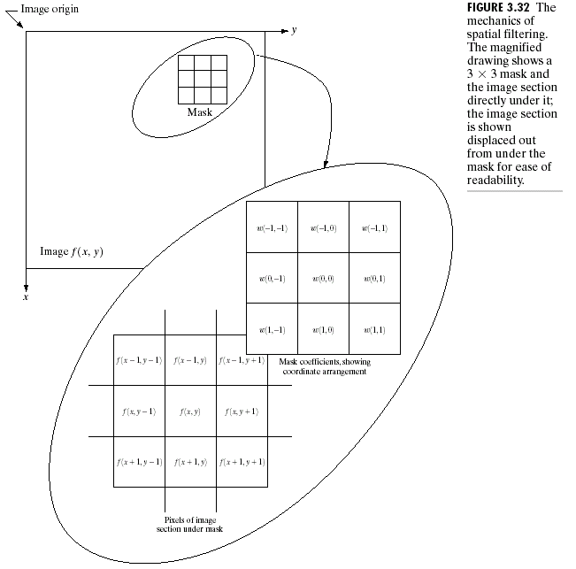
Image Enhancement in the
Spatial Domain
Prof. Suresh Pabboju, IT Dept, CBIT, Hyd

Slide 5
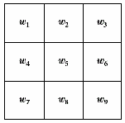
Spatial Filtering
filter (can also be called as mask/
kernel/ template or window)
the values in a filter subimage are referred to as coefficients, rather than pixel.
our focus will be on masks of odd sizes, e.g. 3x3, 5x5,…
Prof. Suresh Pabboju, IT Dept, CBIT, Hyd

Slide 6
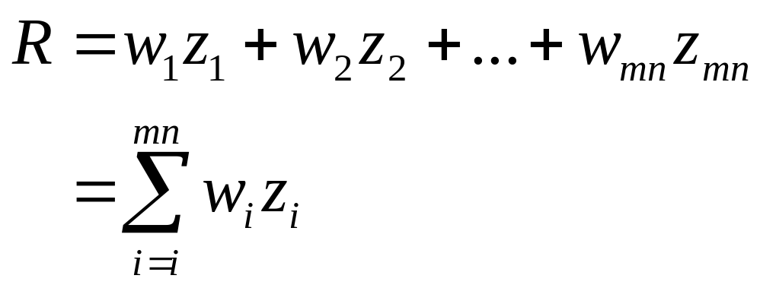
Spatial Filtering Process
simply move the filter mask from point to point in an image.
at each point (x,y), the response of the filter at that point is calculated using a predefined relationship.
Prof. Suresh Pabboju, IT Dept, CBIT, Hyd

Slide 7
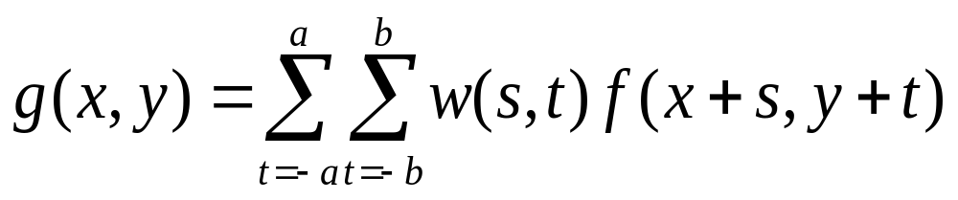
Linear Filtering
Linear Filtering of an image f of size M x N filter mask of size m x n is given by the expression
where a = (m-1)/2 and b = (n-1)/2
To generate a complete filtered image this equation must be applied for x = 0, 1, 2, … , M-1 and y = 0, 1, 2, … , N-1
Prof. Suresh Pabboju, IT Dept, CBIT, Hyd

Slide 8
Smoothing Spatial Filters
used for blurring and for noise reduction
blurring is used in preprocessing steps, such as
  removal of small details from an image prior to object extraction
  bridging of small gaps in lines or curves
noise reduction can be accomplished by blurring with a linear filter and also by a nonlinear filter
Prof. Suresh Pabboju, IT Dept, CBIT, Hyd

Slide 9
Smoothing Linear Filters
output is simply the average of the pixels contained in the neighborhood of the filter mask.
called averaging filters or lowpass filters.
Prof. Suresh Pabboju, IT Dept, CBIT, Hyd

Slide 10
Smoothing Linear Filters
replacing the value of every pixel in an image by the average of the gray levels in the neighborhood will reduce the “sharp” transitions in gray levels.
sharp transitions
  random noise in the image
  edges of objects in the image
thus, smoothing can reduce noises (desirable) and blur edges (undesirable)
Prof. Suresh Pabboju, IT Dept, CBIT, Hyd

Slide 11
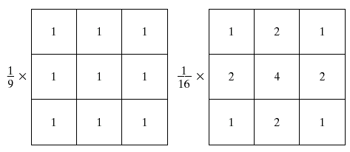
3x3 Smoothing Linear Filters
box filter
weighted average
the center is the most important and other pixels are inversely weighted as a function of their distance from the center of the mask
Prof. Suresh Pabboju, IT Dept, CBIT, Hyd

Slide 12
Weighted average filter
the basic strategy behind weighting the center point the highest and then reducing the value of the coefficients as a function of increasing distance from the origin is simply an attempt to reduce blurring in the smoothing process.
Prof. Suresh Pabboju, IT Dept, CBIT, Hyd

Slide 13
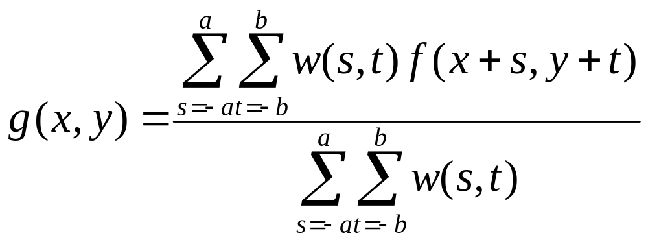
General form : smoothing mask
filter of size mxn (m and n odd)
summation of all coefficient of the mask
Prof. Suresh Pabboju, IT Dept, CBIT, Hyd

Slide 14
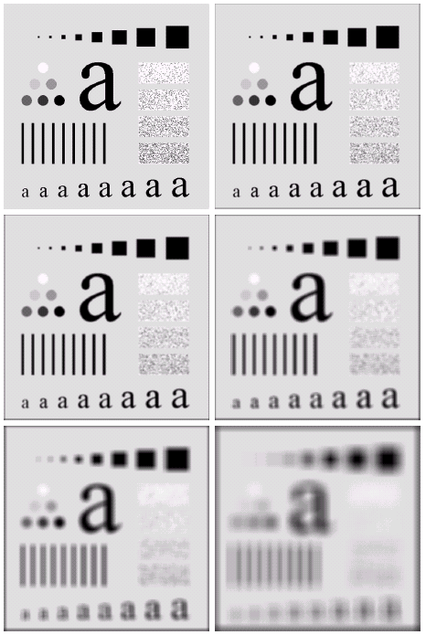
Example
a | b
c | d
e | f
a) original image 500x500 pixel
b) - f). results of smoothing with square averaging filter masks of size n = 3, 5, 9, 15 and 35, respectively.
Note:
  big mask is used to eliminate small objects from an image.
  the size of the mask establishes the relative size of the objects that will be blended with the background.
Prof. Suresh Pabboju, IT Dept, CBIT, Hyd

Slide 15
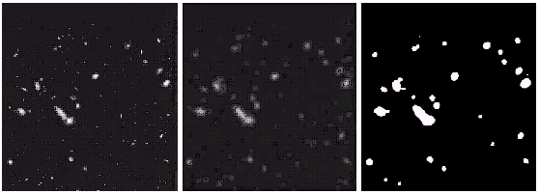
Example
original image
result after smoothing with 15x15 averaging mask
result of thresholding
we can see that the result after smoothing and thresholding, the remains are the largest and brightest objects in the image.
Prof. Suresh Pabboju, IT Dept, CBIT, Hyd

Slide 16
Order-Statistics Filters
(Nonlinear Filters)
the response is based on ordering (ranking) the pixels contained in the image area encompassed by the filter
example
  median filter : R = median{z_{k} |k = 1,2,…,n x n}
  max filter : R = max{z_{k} |k = 1,2,…,n x n}
  min filter : R = min{z_{k} |k = 1,2,…,n x n}
note: n x nis the size of the mask
Prof. Suresh Pabboju, IT Dept, CBIT, Hyd

Slide 17
Median Filters
replaces the value of a pixel by the median of the gray levels in the neighborhood of that pixel (the original value of the pixel is included in the computation of the median)
quite popular because for certain types of random noise (impulse noise  salt and pepper noise) , they provide excellent noise-reduction capabilities, with considering less blurring than linear smoothing filters of similar size.
Prof. Suresh Pabboju, IT Dept, CBIT, Hyd

Slide 18
Median Filters
forces the points with distinct gray levels to be more like their neighbors.
isolated clusters of pixels that are light or dark with respect to their neighbors, and whose area is less than n²/2 (one-half the filter area), are eliminated by an n x n median filter.
eliminated = forced to have the value equal the median intensity of the neighbors.
larger clusters are affected considerably less
Prof. Suresh Pabboju, IT Dept, CBIT, Hyd

Slide 19

Example : Median Filters
Prof. Suresh Pabboju, IT Dept, CBIT, Hyd

Slide 20
Image Sharpening in
Spatial Domain
Prof. Suresh Pabboju, IT Dept, CBIT, Hyd

Slide 21
Sharpening Spatial Filters
to highlight fine detail in an image
or to enhance detail that has been blurred, either in error or as a natural effect of a particular method of image acquisition.
Prof. Suresh Pabboju, IT Dept, CBIT, Hyd

Slide 22
Blurring Vs Sharpening
as we know that blurring can be done in spatial domain by pixel averaging in a neighbors
since averaging is analogous to integration
thus, we can guess that the sharpening must be accomplished by spatial differentiation.
Prof. Suresh Pabboju, IT Dept, CBIT, Hyd

Slide 23
Derivative operator
the strength of the response of a derivative operator is proportional to the degree of discontinuity of the image at the point at which the operator is applied.
thus, image differentiation
  enhances edges and other discontinuities (noise)
  deemphasizes area with slowly varying gray-level values.
Prof. Suresh Pabboju, IT Dept, CBIT, Hyd

Slide 24
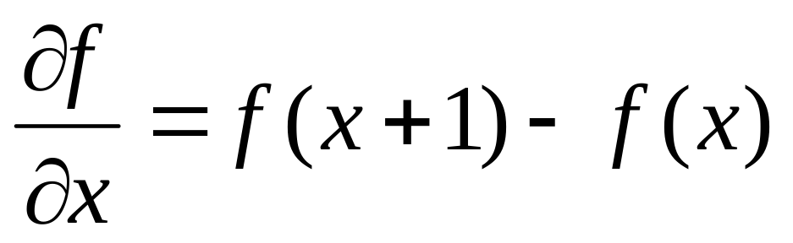
First-order derivative
a basic definition of the first-order derivative of a one-dimensional function f(x) is the difference
Prof. Suresh Pabboju, IT Dept, CBIT, Hyd

Slide 25
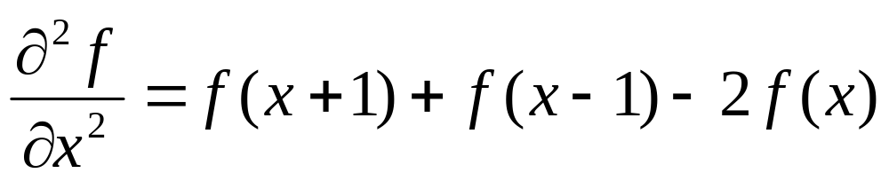
Second-order derivative
similarly, we define the second-order derivative of a one-dimensional function f(x) is the difference
Prof. Suresh Pabboju, IT Dept, CBIT, Hyd

Slide 26
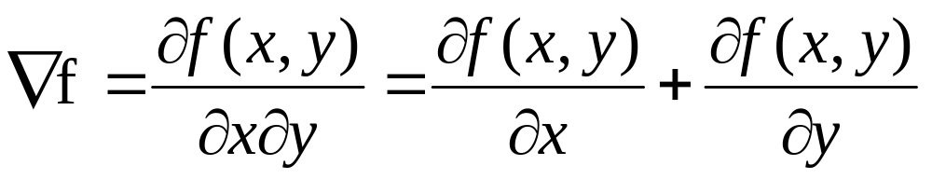
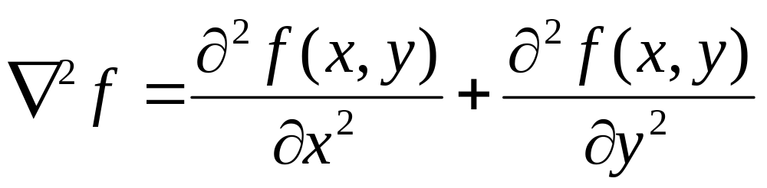
First and Second-order derivative of f(x,y)
when we consider an image function of two variables, f(x,y), at which time we will dealing with partial derivatives along the two spatial axes.
Gradient operator
Laplacian operator
(linear operator)
Prof. Suresh Pabboju, IT Dept, CBIT, Hyd

Slide 27
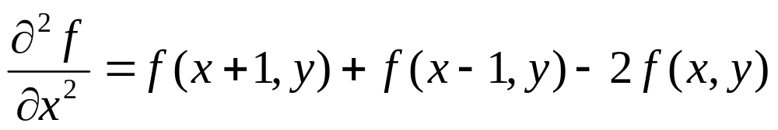
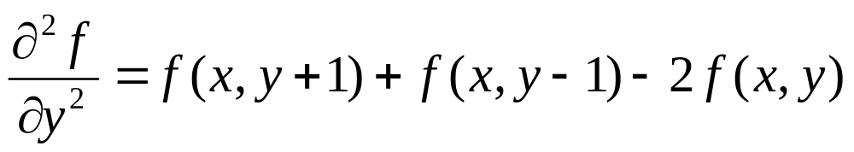
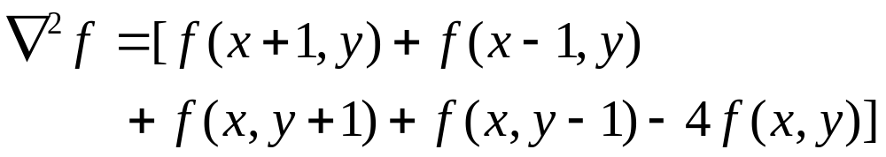
Discrete Form of Laplacian
from
yield,
Prof. Suresh Pabboju, IT Dept, CBIT, Hyd

Slide 28
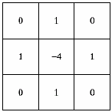
Result Laplacian mask
Prof. Suresh Pabboju, IT Dept, CBIT, Hyd

Slide 29
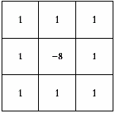
Laplacian mask implemented an extension of diagonal neighbors
Prof. Suresh Pabboju, IT Dept, CBIT, Hyd

Slide 30
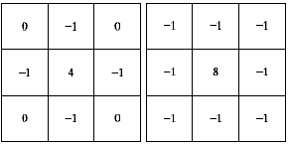
Other implementation of
Laplacian masks
give the same result, but we have to keep in mind that when combining (add / subtract) a Laplacian-filtered image with another image.
Prof. Suresh Pabboju, IT Dept, CBIT, Hyd

Slide 31
Effect of Laplacian Operator
as it is a derivative operator,
  it highlights gray-level discontinuities in an image
  it deemphasizes regions with slowly varying gray levels
tends to produce images that have
  grayish edge lines and other discontinuities, all superimposed on a dark,
  .
Prof. Suresh Pabboju, IT Dept, CBIT, Hyd

Slide 32
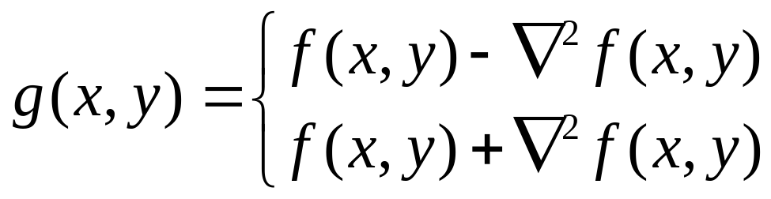
Correct the effect of featureless background
easily by adding the original and Laplacian image.
be careful with the Laplacian filter used
if the center coefficient of the Laplacian mask is negative
if the center coefficient of the Laplacian mask is positive
Prof. Suresh Pabboju, IT Dept, CBIT, Hyd

Slide 33
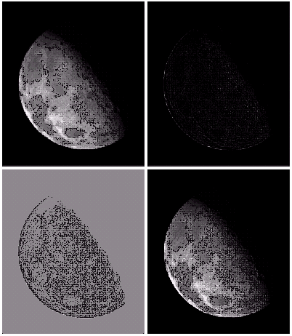
Example
a) image of the North pole of the moon
b) Laplacian-filtered image with
c) Laplacian image scaled for display purposes
d) image enhanced by addition with original image
1 | 1 | 1
1 | -8 | 1
1 | 1 | 1
Prof. Suresh Pabboju, IT Dept, CBIT, Hyd

Slide 34
Mask of Laplacian + addition
to simply the computation, we can create a mask which do both operations, Laplacian Filter and Addition the original image.
Prof. Suresh Pabboju, IT Dept, CBIT, Hyd

Slide 35
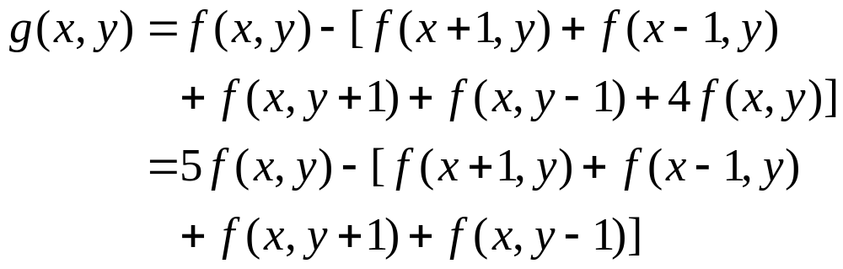
Mask of Laplacian + addition
0 | -1 | 0
-1 | 5 | -1
0 | -1 | 0
Prof. Suresh Pabboju, IT Dept, CBIT, Hyd

Slide 36
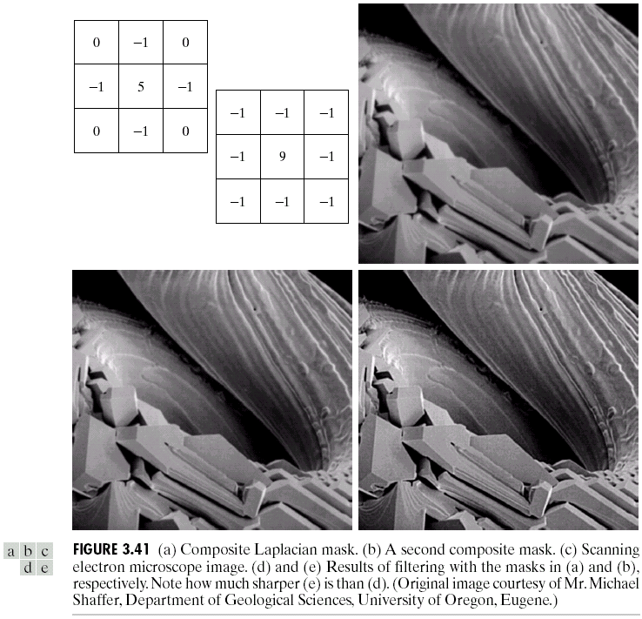
Example
Prof. Suresh Pabboju, IT Dept, CBIT, Hyd

Slide 37

Note
0 | -1 | 0
-1 | 5 | -1
0 | -1 | 0
0 | 0 | 0
0 | 1 | 0
0 | 0 | 0
0 | -1 | 0
-1 | 4 | -1
0 | -1 | 0
=
+
0 | -1 | 0
-1 | 9 | -1
0 | -1 | 0
0 | 0 | 0
0 | 1 | 0
0 | 0 | 0
0 | -1 | 0
-1 | 8 | -1
0 | -1 | 0
=
+
Prof. Suresh Pabboju, IT Dept, CBIT, Hyd

Slide 38
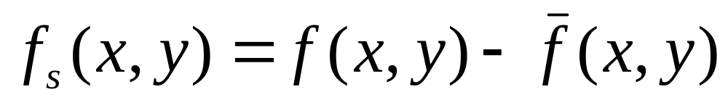
Unsharp masking
sharpened image = original image – blurred image
to subtract a blurred version of an image produces sharpening output image.
Prof. Suresh Pabboju, IT Dept, CBIT, Hyd

Slide 39
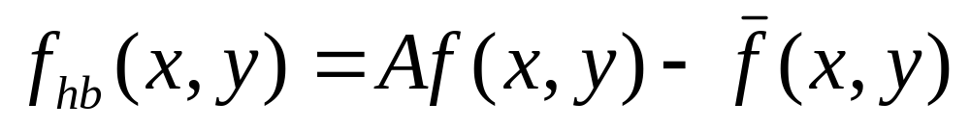
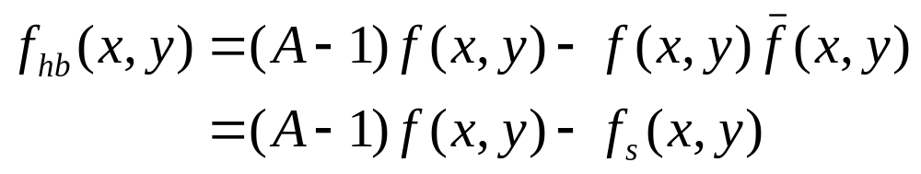
High-boost filtering
generalized form of Unsharp masking
A ≥ 1
Prof. Suresh Pabboju, IT Dept, CBIT, Hyd

Slide 40
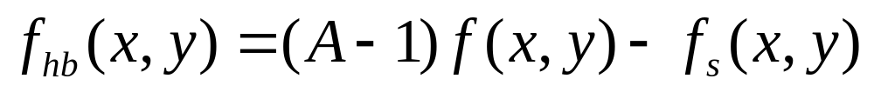
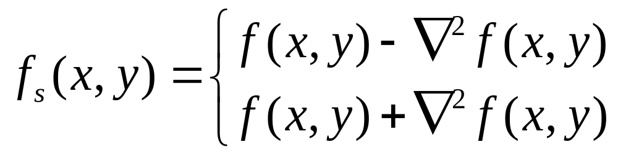
High-boost filtering
if we use Laplacian filter to create sharpen image f_{s}(x,y) with addition of original image
Prof. Suresh Pabboju, IT Dept, CBIT, Hyd

Slide 41
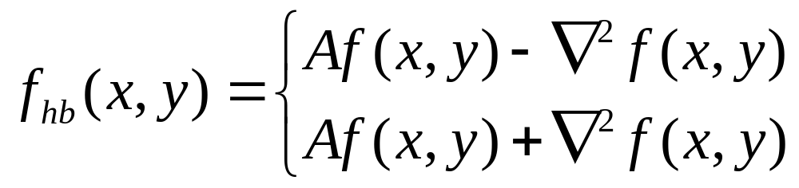
High-boost filtering
if the center coefficient of the Laplacian mask is negative
yields
if the center coefficient of the Laplacian mask is positive
Prof. Suresh Pabboju, IT Dept, CBIT, Hyd

Slide 42
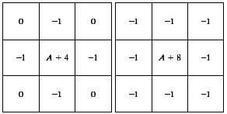
High-boost Masks
A ≥ 1
if A = 1, it becomes “standard” Laplacian sharpening
Prof. Suresh Pabboju, IT Dept, CBIT, Hyd

Slide 43
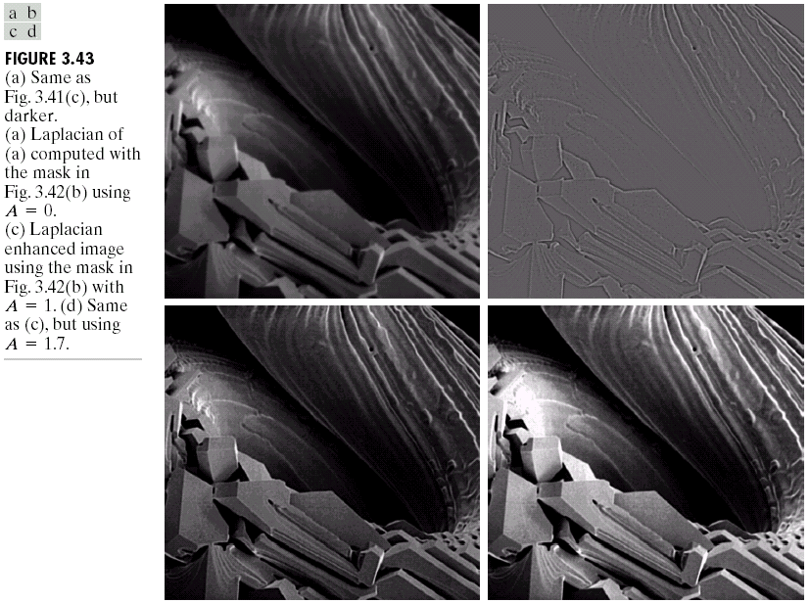
Example
Prof. Suresh Pabboju, IT Dept, CBIT, Hyd

Slide 44
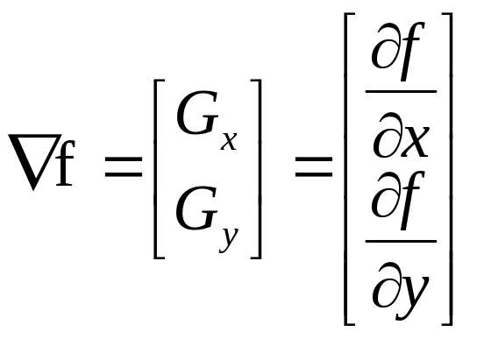
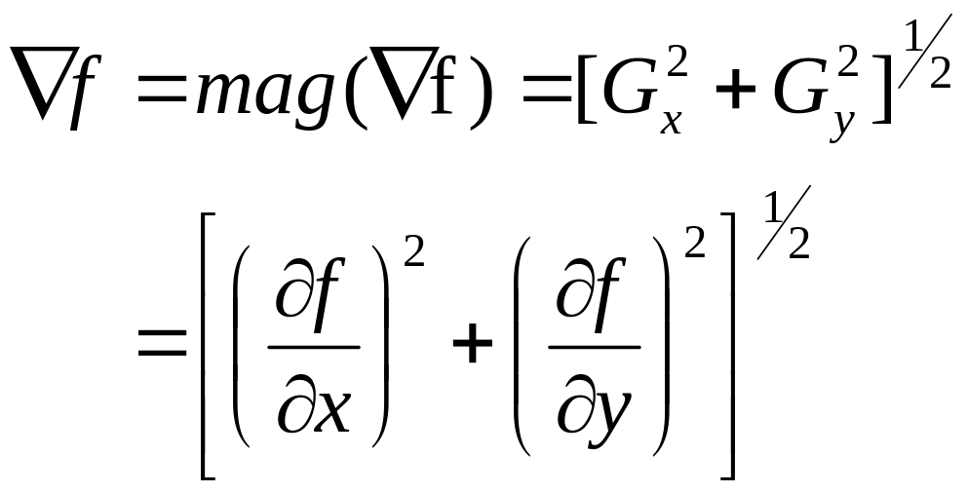
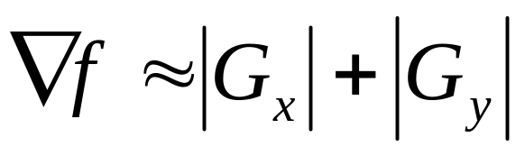
Gradient Operator
first derivatives are implemented using the magnitude of the gradient.
commonly approx.
the magnitude becomes nonlinear
Prof. Suresh Pabboju, IT Dept, CBIT, Hyd

Slide 45
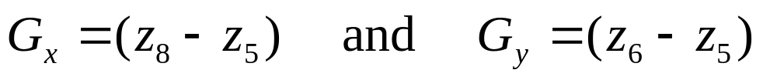
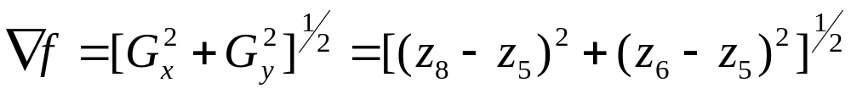
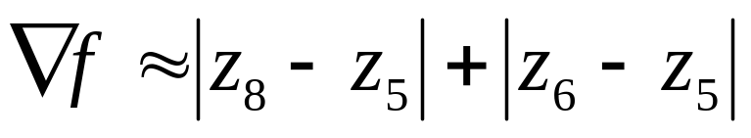
Gradient Mask
z₁ | z₂ | z₃
z₄ | z₅ | z₆
z₇ | z₈ | z₉
simplest approximation, 2x2
Prof. Suresh Pabboju, IT Dept, CBIT, Hyd

Slide 46
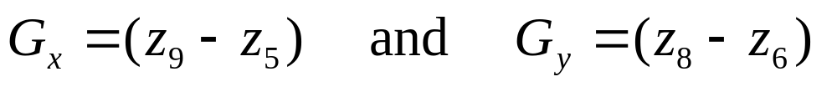
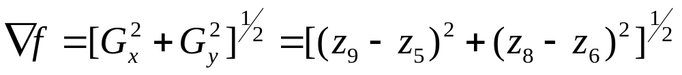
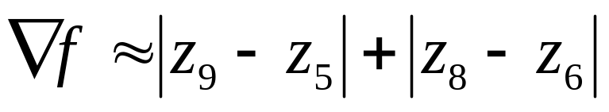

Gradient Mask
z₁ | z₂ | z₃
z₄ | z₅ | z₆
z₇ | z₈ | z₉
Roberts cross-gradient operators, 2x2
Prof. Suresh Pabboju, IT Dept, CBIT, Hyd

Slide 47
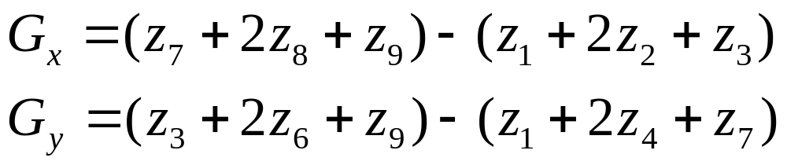

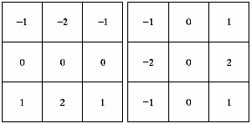
Gradient Mask
z₁ | z₂ | z₃
z₄ | z₅ | z₆
z₇ | z₈ | z₉
Sobel operators, 3x3
the weight value 2 is to achieve smoothing by giving more important to the center point
Prof. Suresh Pabboju, IT Dept, CBIT, Hyd

Slide 48
Note
the summation of coefficients in all masks equals 0, indicating that they would give a response of 0 in an area of constant gray level.
Prof. Suresh Pabboju, IT Dept, CBIT, Hyd

Slide 49
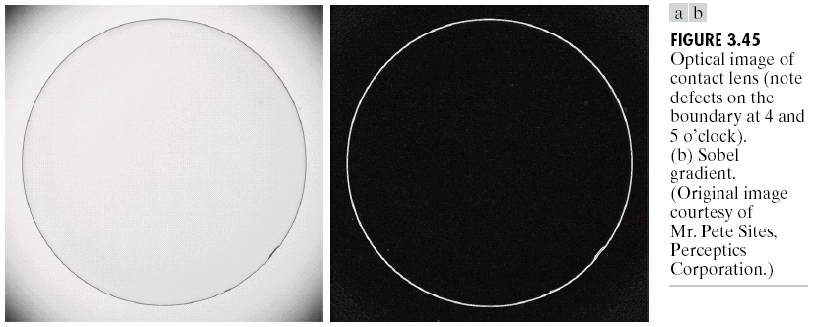
Example
Prof. Suresh Pabboju, IT Dept, CBIT, Hyd

Slide 50
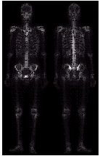
Example of Combining Spatial Enhancement Methods
want to sharpen the original image and bring out more skeletal detail.
problems: narrow dynamic range of gray level and high noise content makes the image difficult to enhance
Prof. Suresh Pabboju, IT Dept, CBIT, Hyd

Slide 51
Example of Combining Spatial Enhancement Methods
solve :
  Laplacian to highlight fine detail
  gradient to enhance prominent edges
  gray-level transformation to increase the dynamic range of gray levels
Prof. Suresh Pabboju, IT Dept, CBIT, Hyd

Slide 52
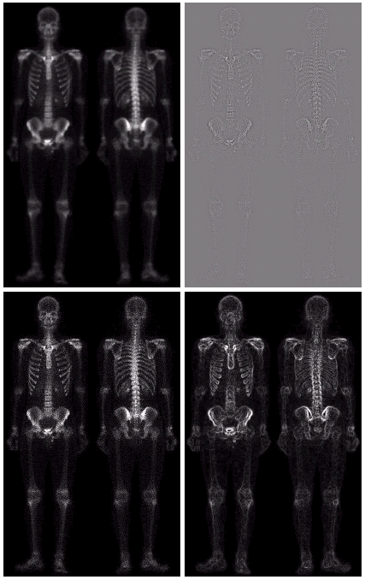
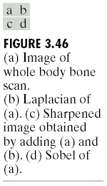
Prof. Suresh Pabboju, IT Dept, CBIT, Hyd

Slide 53
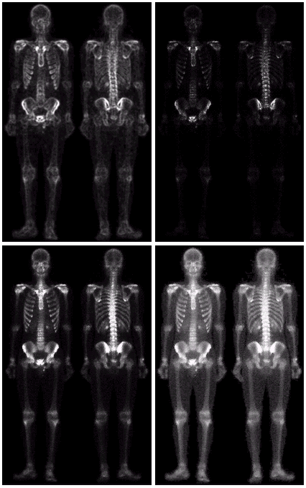
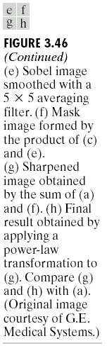
Prof. Suresh Pabboju, IT Dept, CBIT, Hyd

